Slide 1
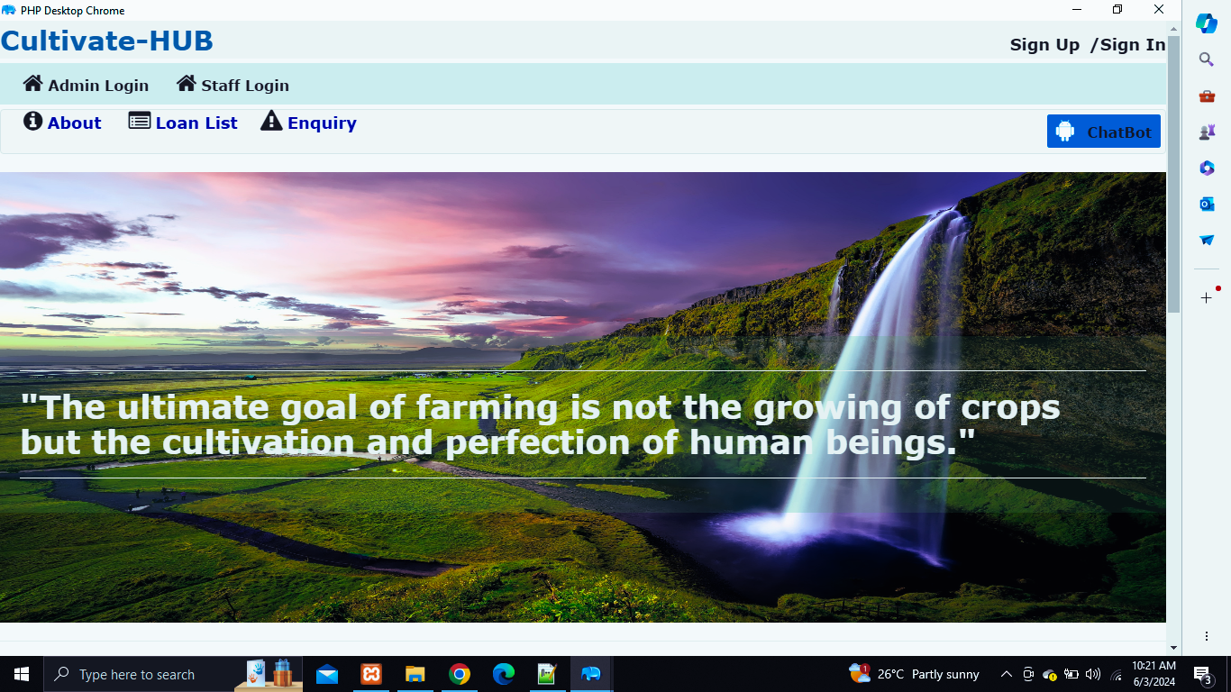


CULITVATE-HUB

Slide 2

CULTIVATE-HUB
INTRODUCTION
Cultivate Hub Agriculture Project is a transformative initiative that harnesses the power of collaboration and technology to revolutionize the agricultural sector. The Cultivate Hub aims to create a thriving agricultural ecosystem. Leveraging advanced data analytics and sensors to provide farmers with real-time insights into soil conditions, weather patterns, and crop health. Creating a community where farmers can share knowledge, receive technical assistance, and access resources. The Cultivate Hub Agriculture Project is a testament to the power of collaboration and innovation in addressing the challenges of the modern agricultural landscape. It represents a transformative step towards a sustainable and prosperous future for the food system and the planet as a whole.

Slide 3


ABSTRACT
Agriculture Hub is an architecture innovation that will serve as the central facility that is dedicated to rural revitalization and economic inclusiveness within the locality. This project is a fundamental architectural initiative which is specifically dedicated to the uplifting of farmers’ way of living and proving to the nation and to the world that architecture can create an immense impact in agricultural development. This project is a fundamental architectural initiative which is specifically dedicated to the uplifting of farmers’ way of living and proving to the nation and to the world that architecture can create an immense impact in agricultural development.
01

Slide 4
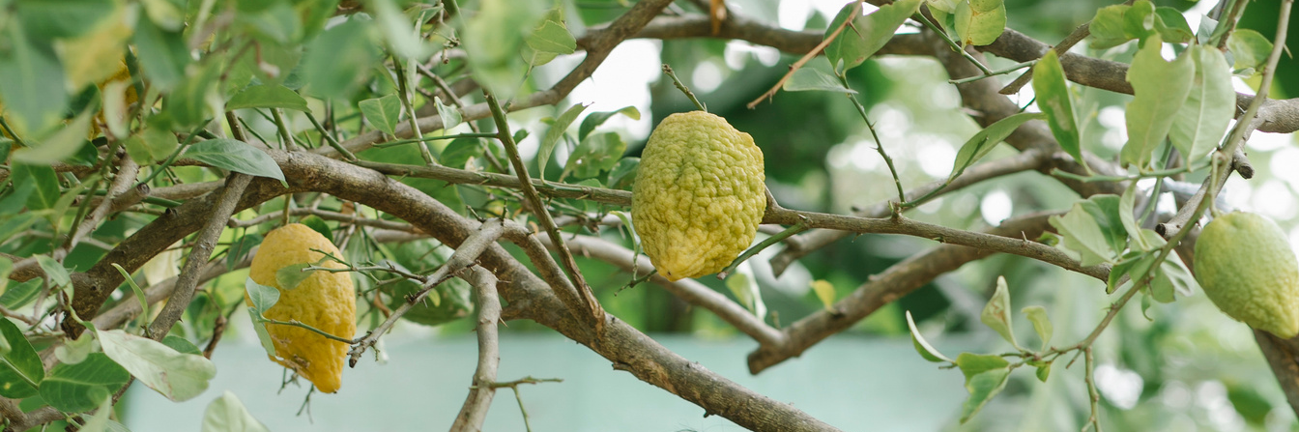
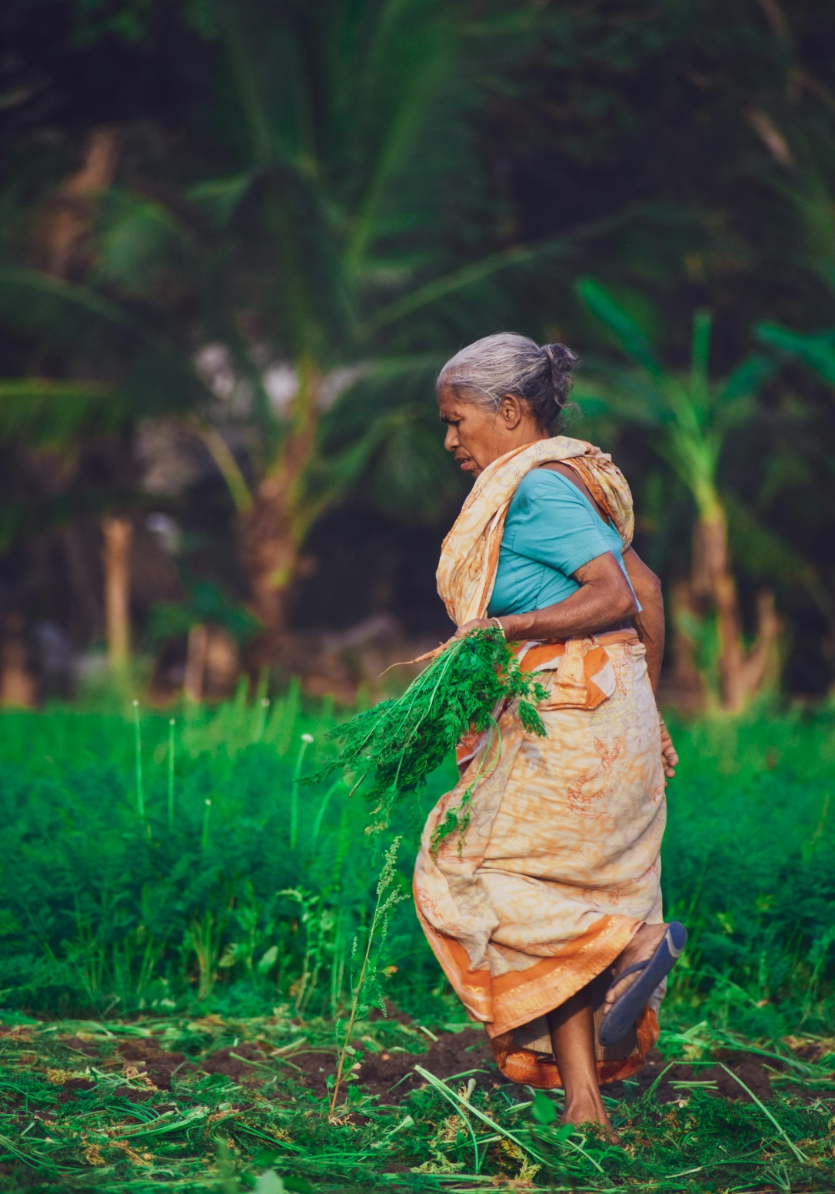
CULTIVATE-HUB
AIM
“Cultivate Hub” is a comprehensive online platform dedicated to serving the diverse needs of modern agriculture. Cultivate Hub offers a wealth of resources and information to empower farmers and agribusiness professionals.

Slide 5

CULTIVATE-HUB
DESCRIPTION
The website features a user-friendly interface designed to streamline navigation and accessibility. Users can explore a wide range of topics covering crop cultivation, livestock management, agricultural technology, market trends, and more. Whether you're a seasoned farmer looking to get an advance pay cheque in agriculture, Cultivate Hub provides something for everyone.

Slide 6
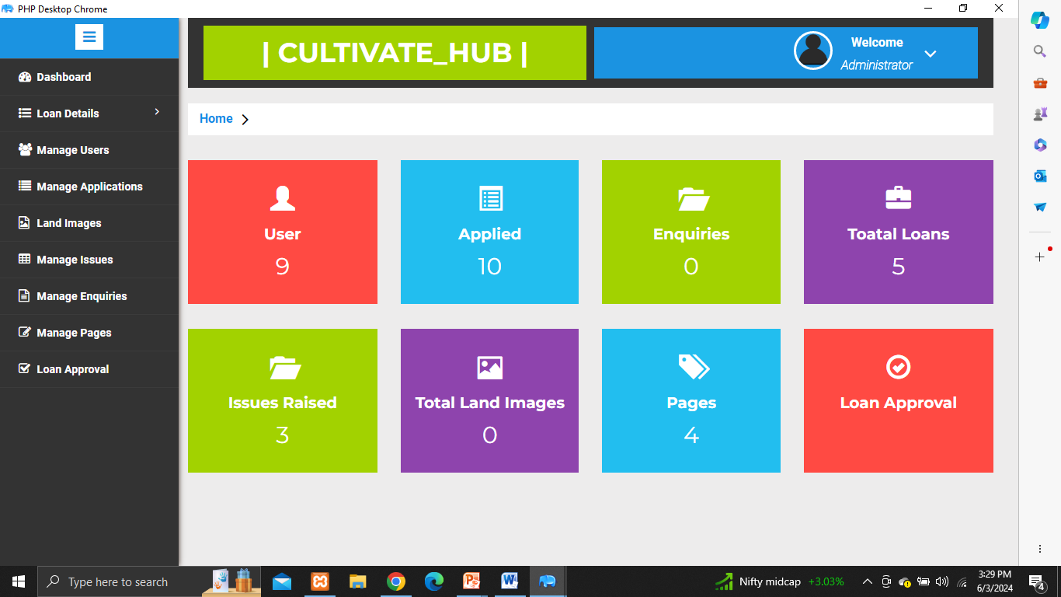
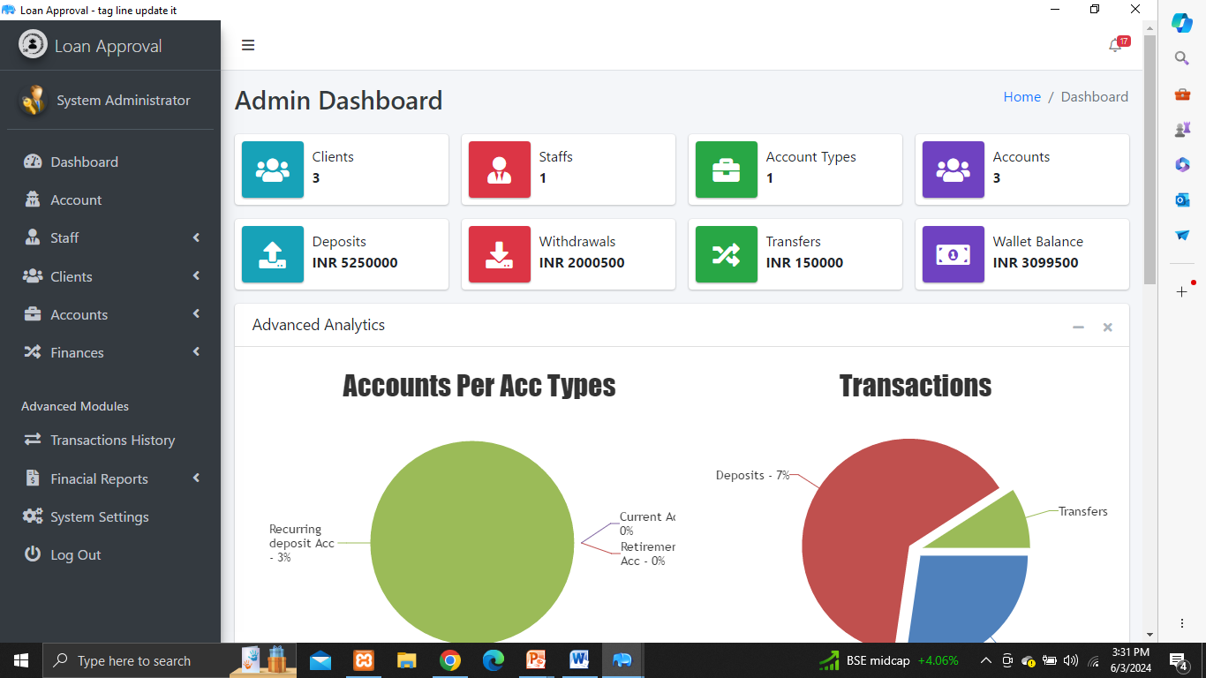
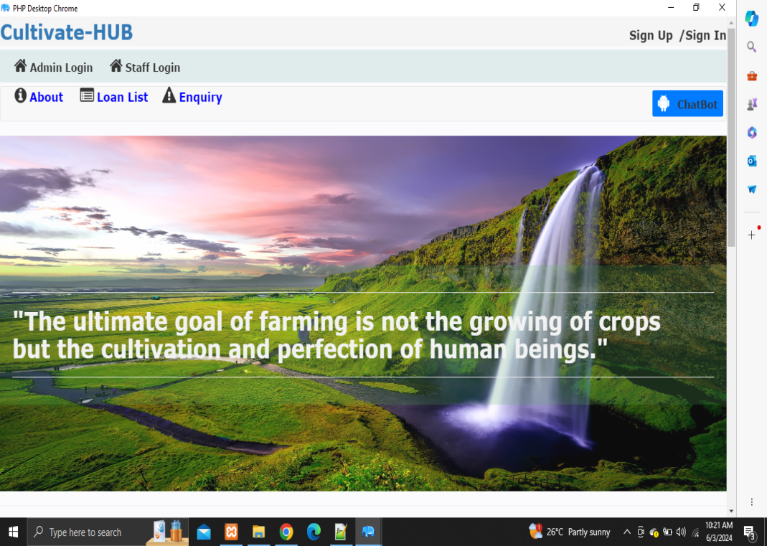
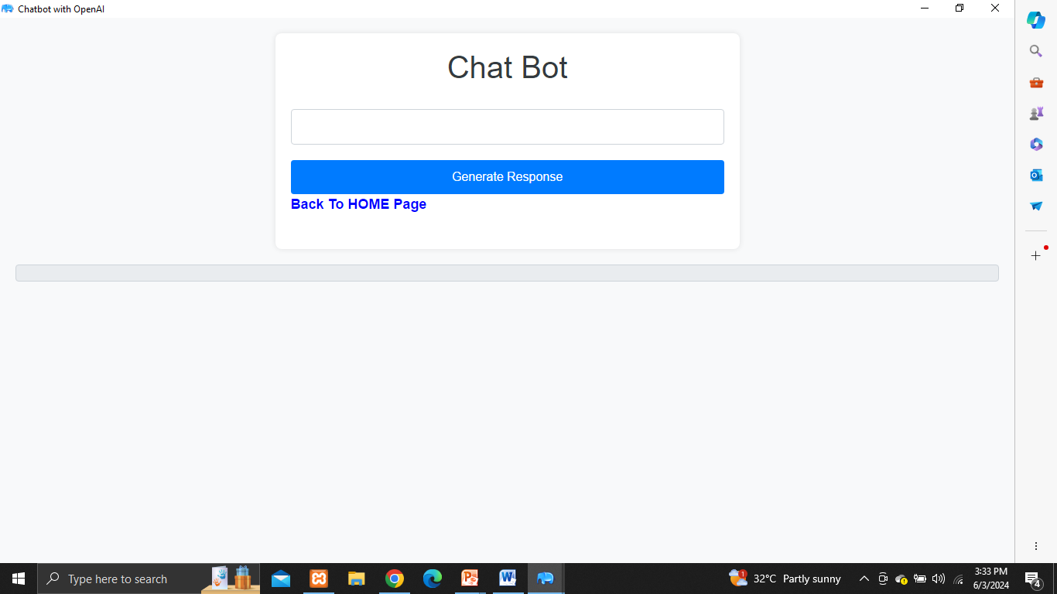
CULTIVATE-HUB
Admin Panel
Dashboard
Sign-up and Login
User roles and permissions (e.g., farmer, researcher)
Personalized user dashboard and Overview of recent activity and notifications
Crop Cultivation Module
Agricultural Technology Module
Crop selection and planning
Soil preparation and management
Planting and harvesting schedules
Guidance on their usage and maintenance

Slide 7
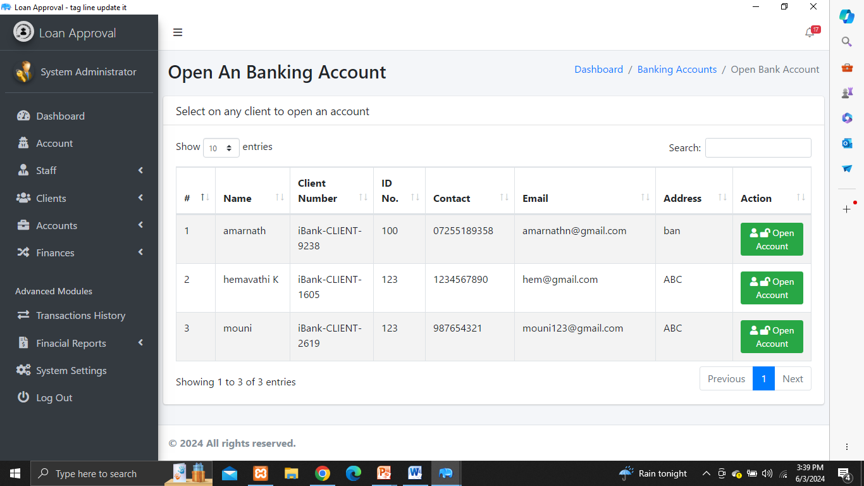
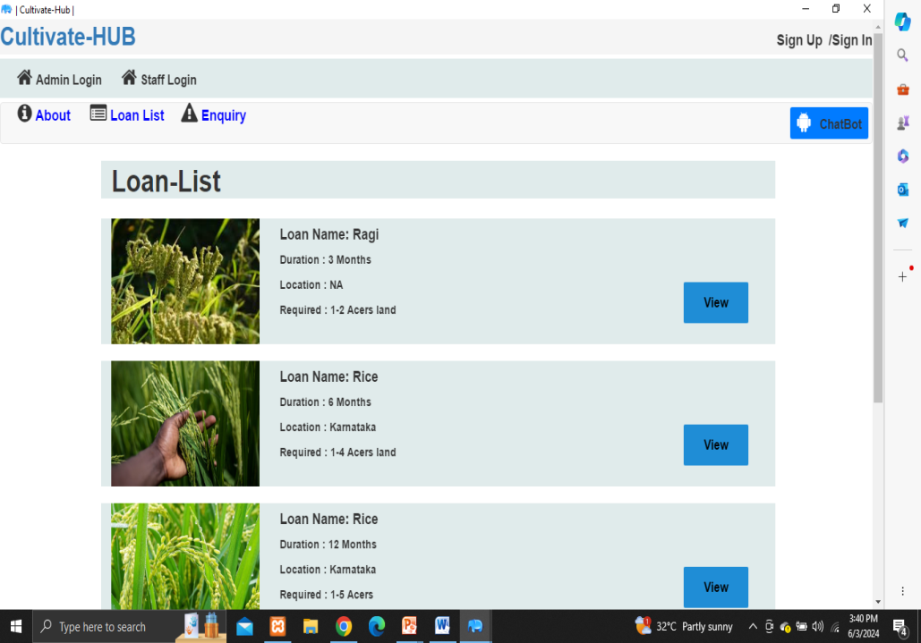
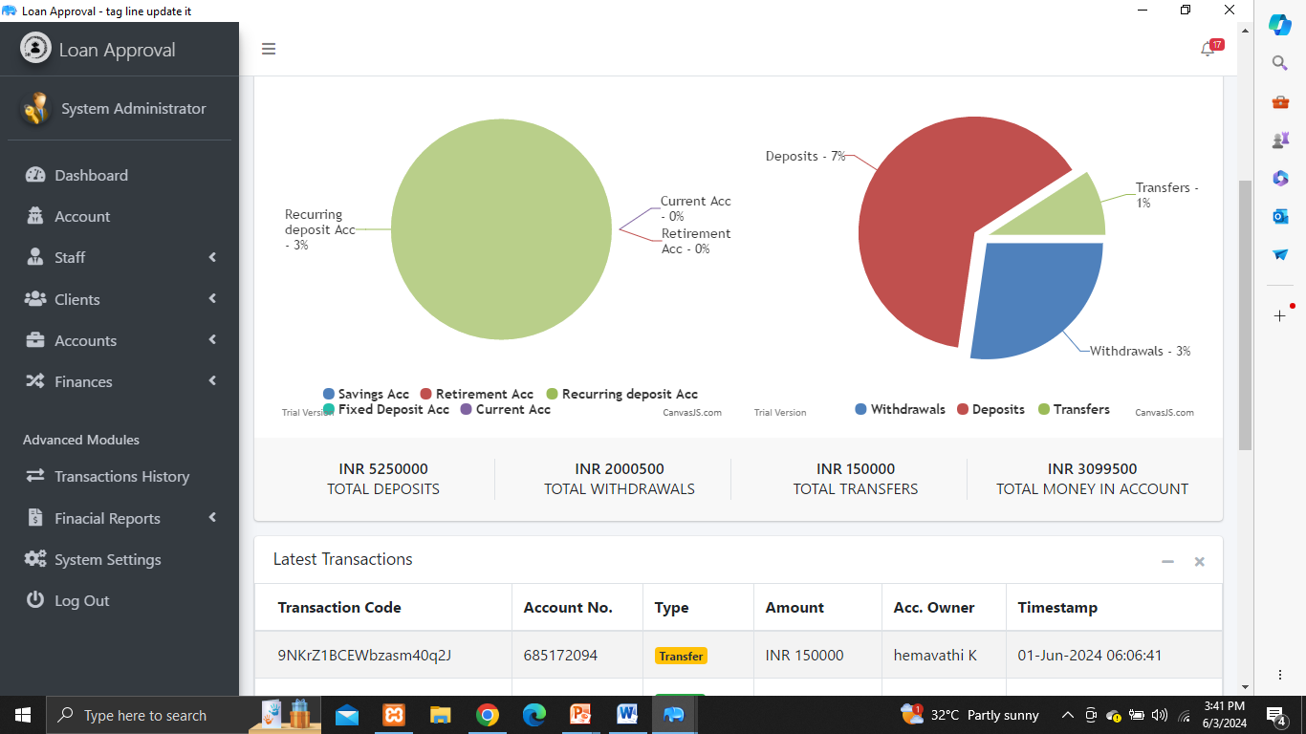
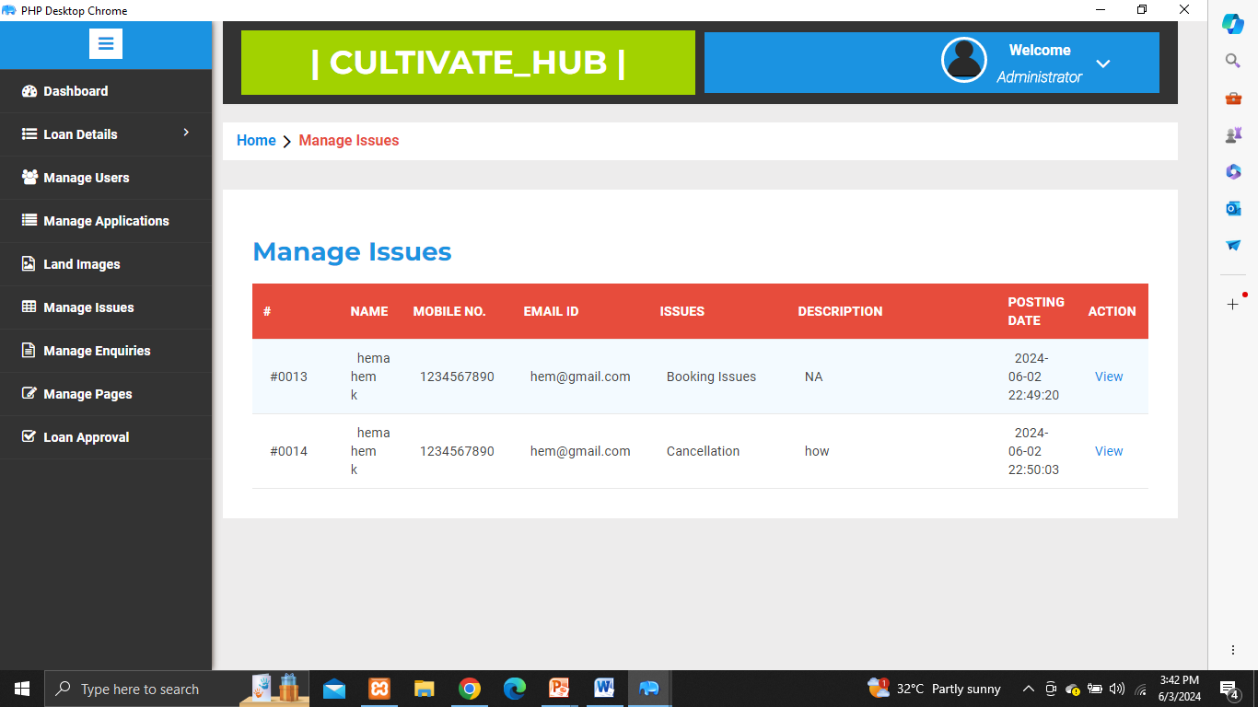
CULTIVATE-HUB
Loan Application Facilities
Market Trends Module
Banks specializing in agricultural financing offer loan products for farmers.
Price forecasting, Marketing strategies, and Access to buyers and sellers
Financial Management Module
Feedback and Support Module
Budgeting and expense tracking
Loan and credit management
Chatbots for users to discuss and User satisfaction surveys.

Slide 8
CULTIVATE-HUB
SYSTEM REQUIREMENTS
HARDWARE REQUIREMENTS
PROCESSOR : INTEL CORE I3
INPUT DEVICE : KEYBOARD AND
MOUSE
OUTPUT DEVICE : MONITOR
RAM : 8 GB
HARDDISK SPACE : 8 GB
SYSTEM TYPE : 64 bit-Operating system
SOFTWARE REQUIREMENTS
OS : WINDOWS 10
FRONT END : CSS, HTML, PHP, JavaScript
BACK END : MYSQL
SERVER : XAMPP

Slide 9

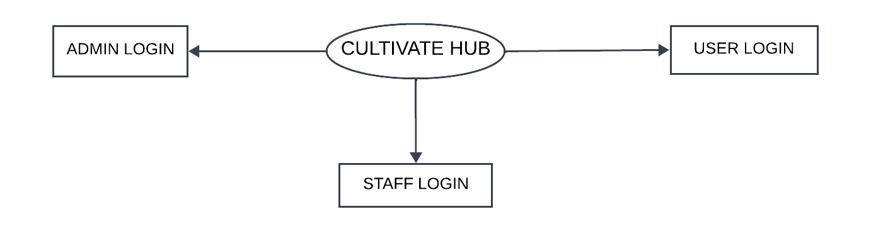
CULTIVATE-HUB
DATA FLOW DIAGRAM
LEVEL-0

Slide 10
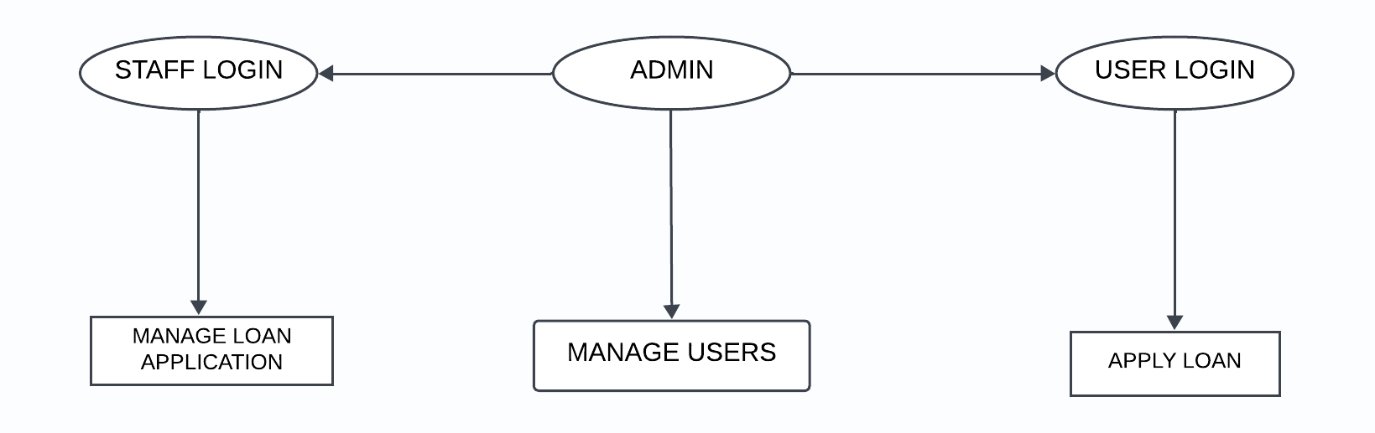
CULTIVATE-HUB
DATA FLOW DIAGRAM
LEVEL-1

Slide 11
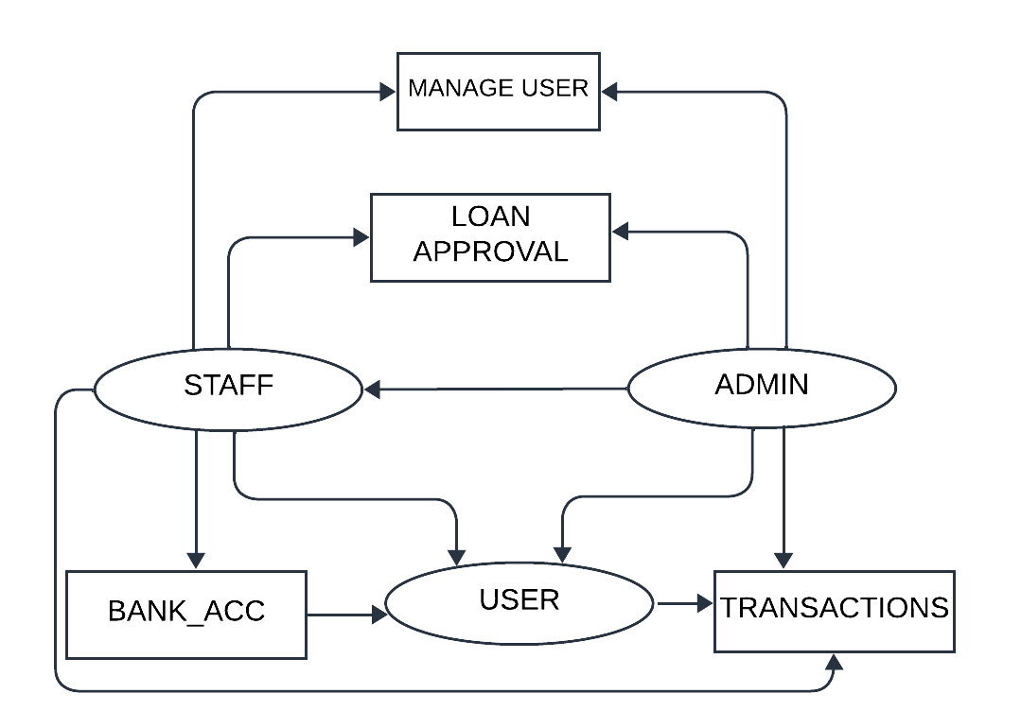
CULTIVATE-HUB
DATA FLOW DIAGRAM
LEVEL-2

Slide 12
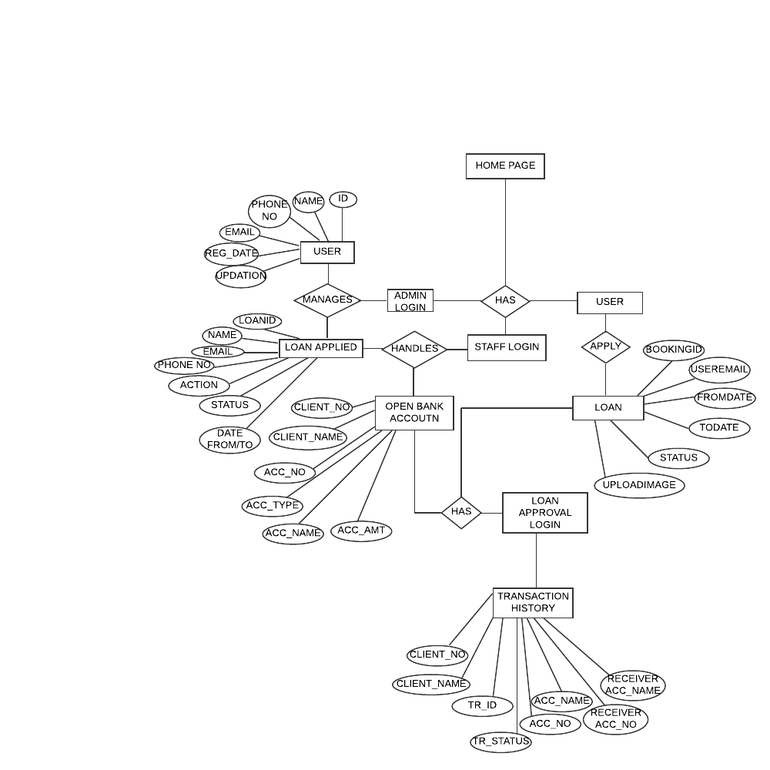
CULTIVATE-HUB
ER DIAGRAM

Slide 13
CULTIVATE-HUB
CONCLUSION
Cultivate Hub is a comprehensive platform that caters to the diverse needs of farmers, offering valuable insights and resources for crop cultivation, livestock management, and agricultural technology. From market trends to advance pay cheques in agriculture, Cultivate Hub is a one-stop destination for all things agriculture. Its user-friendly design ensures easy navigation and accessibility, making it an indispensable resource for anyone involved in the agricultural industry.

Slide 14
CULTIVATE-HUB
FUTURE SCOPE
E-commerce Platform: Adding an e-commerce platform to allow farmers to buy and sell agricultural products directly through the website.
Mobile App: Develop a mobile app to provide farmers with access to the platform on the go. This could include features for capturing and uploading photos, videos, and other media, as well as accessing real-time data and notifications.
Partnerships and Collaborations: Forming partnerships and collaborations with other organizations in the agriculture industry.

Slide 15
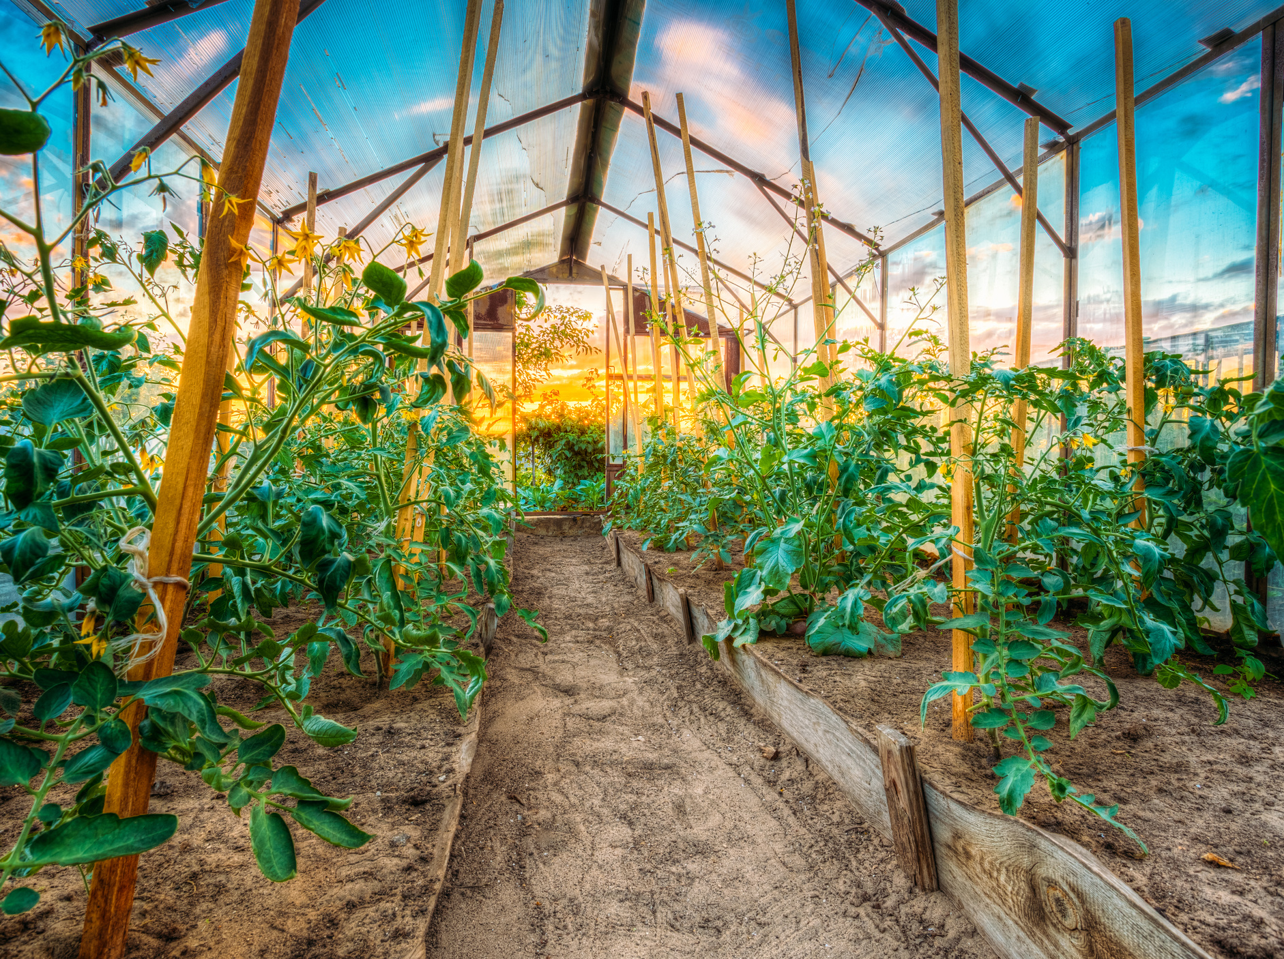
CULTIVATE-HUB
Thank You

